Slide 1
Globalisation & Development
ICT4D
Lecture-4
25 FEB 2023

Slide 2
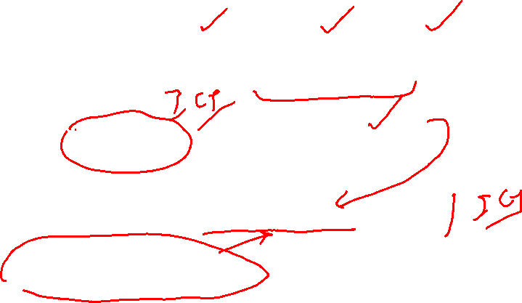
What we intend to Discuss
Globalisation- meaning, perspectives, dimensions
Linkage between Globalisation and Development
How Technology propelled Globalisation
How Globalisation propelling Technology
ICT4D and globalisation

Slide 3
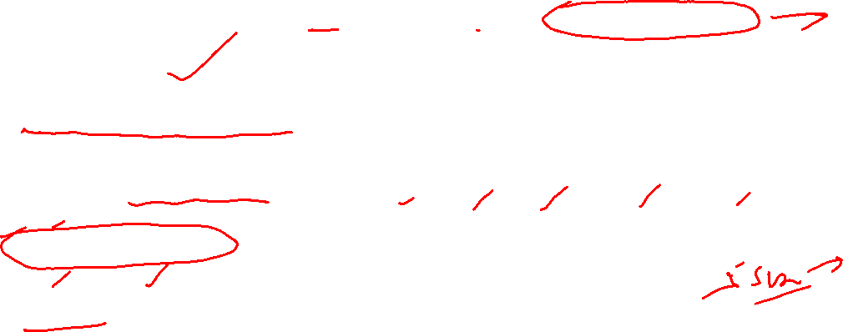
Let us pick up the thread- Development
Development is highly contested concept having wide ranges of meanings and connotations
In common parlance, it denotes a process of growth and progression towards betterment; a positive growth which is considered qualitatively good
It is a value judgemental concept, highly political and linked to power structure in society
Development as a discourse denotes various meanings getting assigned to the word development through narratives, speech, communication, language.
Dimensions of development- Economic, Social, Cultural, Political, Environmental, Human
Human development: Increasing choices to have meaningful life: Health, Education, Resources
Alternate perspectives on Development: Marxian and Gandhian model

Slide 4
GLOBALISATION & DEVELOPMENT

Slide 5
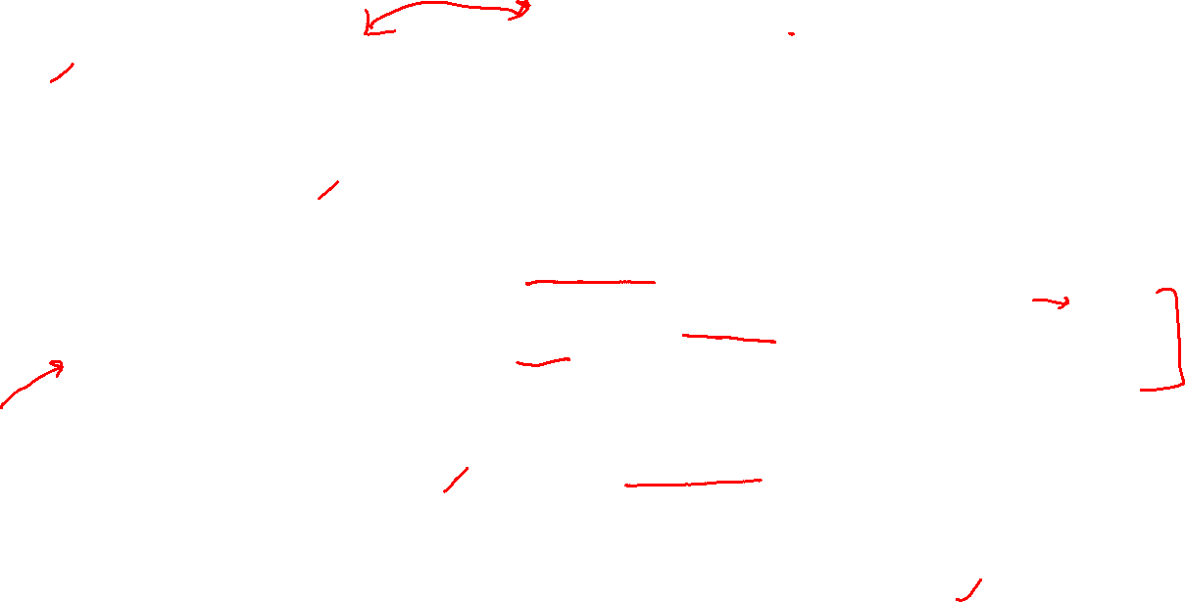
GLOBALISATION: Meaning & Definitions
Worldwide Interconnectedness and interdependence of people, places, ideas, information, objects, activities, and exchanges ; breadth of interconnectedness stretched globally, and its intensity increased manifold
Globalization refers to a multidimensional set of social processes that create, multiply, stretch, and intensify worldwide social interdependencies and exchanges while at the same time fostering in people a growing awareness of deepening connections between the local and the distant. (Steger )
Intensification of worldwide social relations which link distant localities in such a way that local happenings are shaped by events occurring many miles away and vice versa. (Anthony Giddens)
Globalization is a trans-planetary process or set of processes involving increasing liquidity and the growing multi-directional flows of people, objects, places, and information, as well as the structures they encounter and create that are barriers to, or expedite, those flows (Ritzer)
Globalization as a concept refers both to the compression of the world and the intensification of consciousness of the world as a whole. (Roland Robertson)
Globalization may be thought of as processes which embodies a transformation in the spatial organization of social relations and transactions - assessed in terms of their extensity, intensity, velocity and impact generating trans-continental or inter-regional flows and networks of activity, interaction, and the exercise of power (David Held)

Slide 6
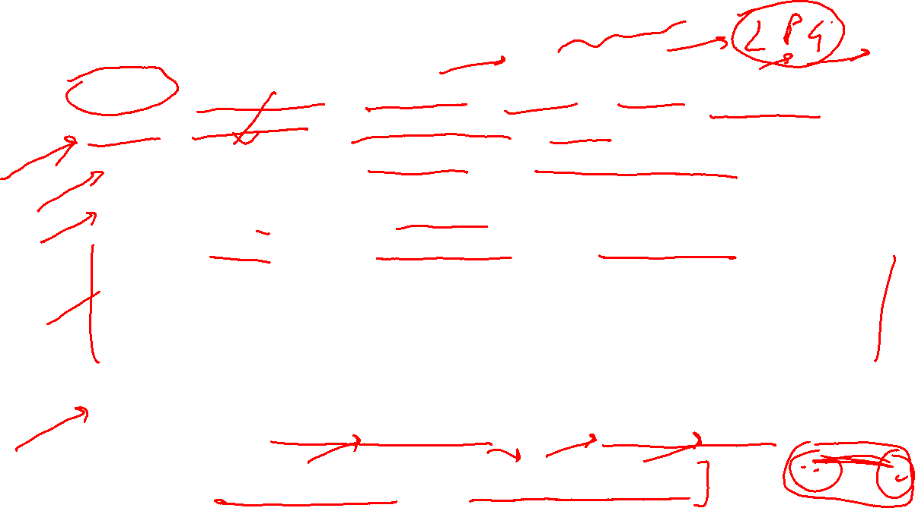
Features of globalization-1/2
Process, a condition, structure, a force, Policy, marketing strategy, discourse, predicament, an age?
Globality: condition ; Globalism: ideology of globalization ; Globalization: processes transforming our present social condition into one of globality ; Denotes movement towards greater interdependence, interconnectedness, and integration
Global Structure : Inter-governmental organizations (IGO) & IO –UN, WTO, IMF, World Bank; International NGOs- Amnesty International, Trans-national Corporations (TNCs)- Walmart & Amazon, Global movements, International Civil Society
Post Modern Global age beginning from the end of cold war; Neo liberal era- free market economy and liberal democracy sweeping the world
Rise of ‘supraterritoriality’ or ‘deterritorialization’
Notes:
Doctors Without Borders, Amnesty International, the Union of Concerned Scientists, the World Economic Forum,
expansion and the stretching of social relations, activities, and interdependencies
intensification and acceleration of social exchanges and activities. a social condition characterized by the existence of global economic, political, cultural, and environmental interconnections and flows that make many of the currently existing borders and boundaries irrelevant
globalization involves the creation of new and the multiplication of existing social networks and activities overcoming traditional political, economic, cultural, and geographical boundaries

Slide 7
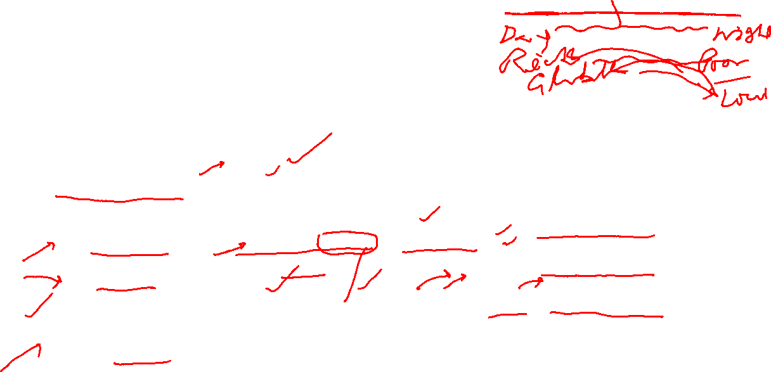
Features of globalization-2/2
A spatial continuum with the 'local' and the 'global’ at extremes and 'national' and the 'regional’ at the centre.
Compresses the time and space aspects of human interactions (James Mittelman)
Role of Markets, IGO, INGOs increasing at the cost of Role of State/govt
Reconfiguration of the idea of Sovereignty, state, nation and Nation-state
Multi-actor global politics/IR- nation-state, NGOs, MNC/TNC, global movements, Global civil society, International regime & organizations
Blurring the line between ‘national’ and ‘international’ in areas of policy making, and governance
Multiple Dimensions- economic, social, political, cultural, technological
Heated Debate and alternative perspectives on its origin, driving forces, extent, impacts, and supporting ideologies

Slide 8
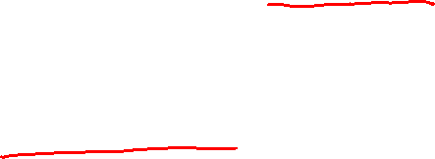
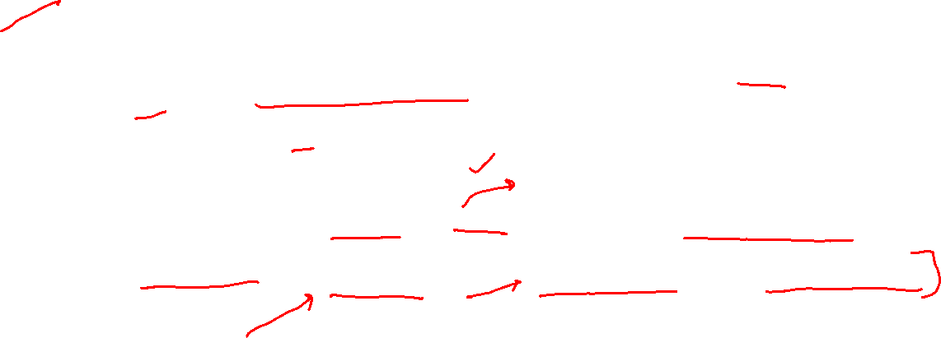
Significance of Globalization
We are living in globalized world- touches one way or other all aspects of life of people across the Globe
Deep impact on how Researches are conducted, technologies are developed, deployed and utilized
Has impacted nature, role, and capacity of nation-states and how citizen relates to the state/Govt.
Deeply impacted how we live, work, entertain, and relate to others
Affected ideologies, worldview, and popular culture around the globe

Slide 9
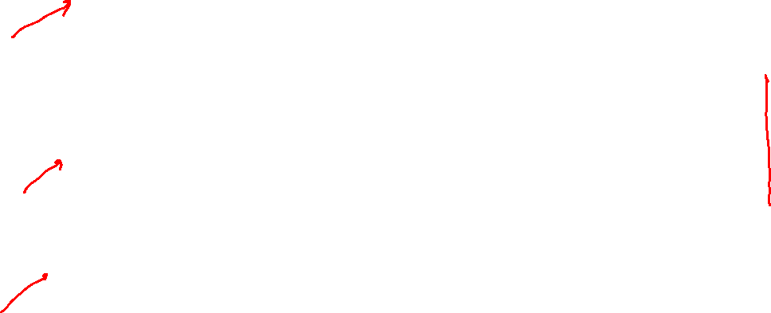
Historical phases of Globalization
Colonialism, led by British empire, as outer world oriented development
18th-19th century
Nations as colonies and colonizers
Individuals as Subjects
Inner oriented ( nation-state centered) development, led by developmentalism & modernization of American
1960s-70s till 1990
Nations as developed/modernized and underdeveloped/backward
Individual as citizen
Neo-Liberal Phase- since 1991: Development through globalization, led by USA and neo-liberal institutionalism- IMF, World Bank, WTO
Individual as Consumer

Slide 10
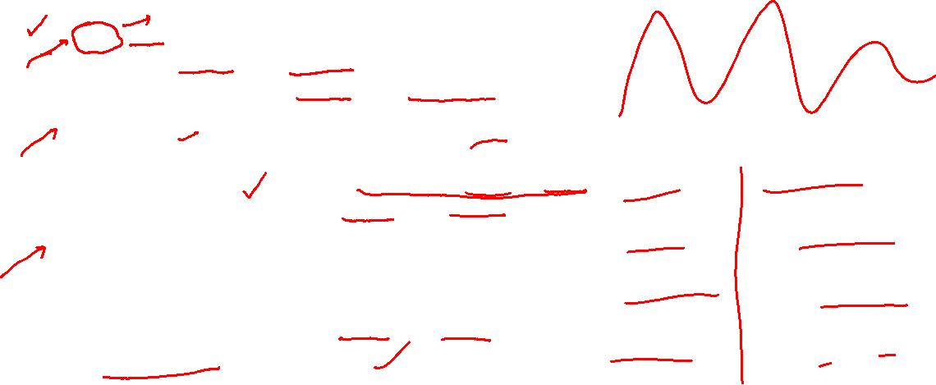
The world is Flat: Thomas Friedman Globalization versions
Globalization 1.0:
1492-1800
Led by exploration and colonization
Shrank the world from a large size to a size medium
Globalization 2.0:
1800-2000
Led by companies(MNCs) globalizing for markets and labour
Revolution in transport and Communication, Internet, WWW
Shrank the world from a size medium to a size small
Globalization 3.0:
Started around 2000
Led by individuals and small group globalizing
Driven by ICT revolution, innovation
Shrinking the world from a size small to a size tiny
Flattening the playing field- making the world Flat

Slide 11
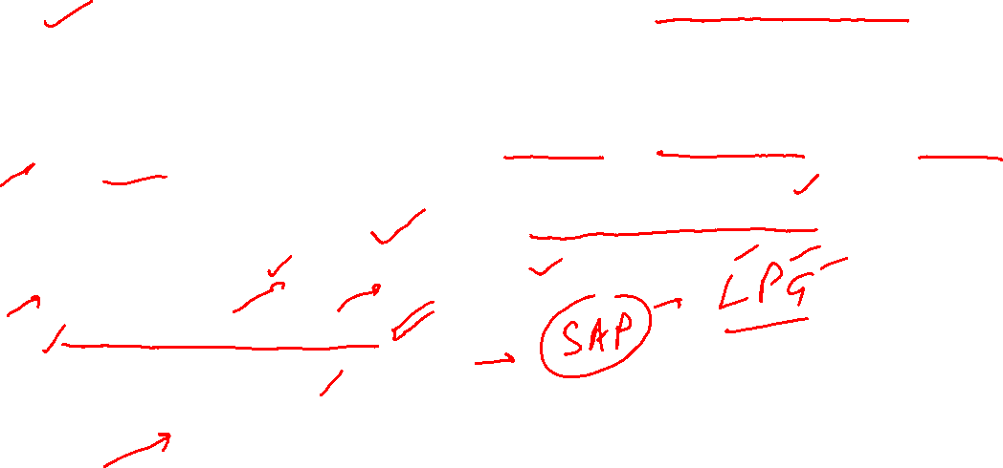
Drivers of Globalization (Thomas Friedman)
Disintegration of USSR, ideological victory of liberalism & capitalism
Unipolar Moment: US as global Hegemon
World united by single ideology, driven by the Hegemon
Worldwide expansion of Neo-liberal ideology- free market capitalism
Technological Breakthrough in transport, communication, and Financial transactions
Revolution in Information & Communication Technologies
Faster planes, containerized Ships, intercontinental multi-modal transport
Electronic fund transfer, and online financial transactions
MNCs/TNCs
IMF, World Bank, WTO
Structural Adjustment programs
Free trade regime
Development as key agenda?

Slide 12
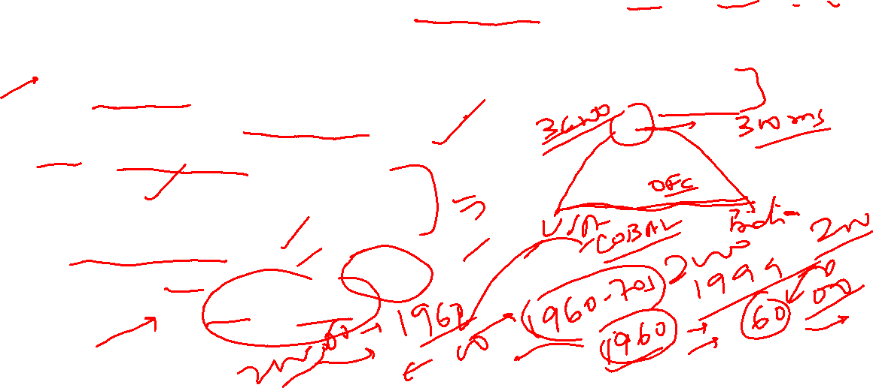
The world is Flat: Thomas Friedman 10 key Drivers
10 events which made the World Flat- level playing field
end of cold war-1989- end of ideological divide of the world
1995- Netscape went public- WWW revolution
JavaScript, SSL. Connected, in real time, people to people anywhere on globe
overinvestment in trans-continental OFC
Y2K: work flow integration
Outsourcing,
Open sourcing, off shoring, insourcing
global supply chaining
informing- Yahoo, MSN Search, Google, Quora, fb, twitter
Wireless access ( wi-fi) and VoIP

Slide 13

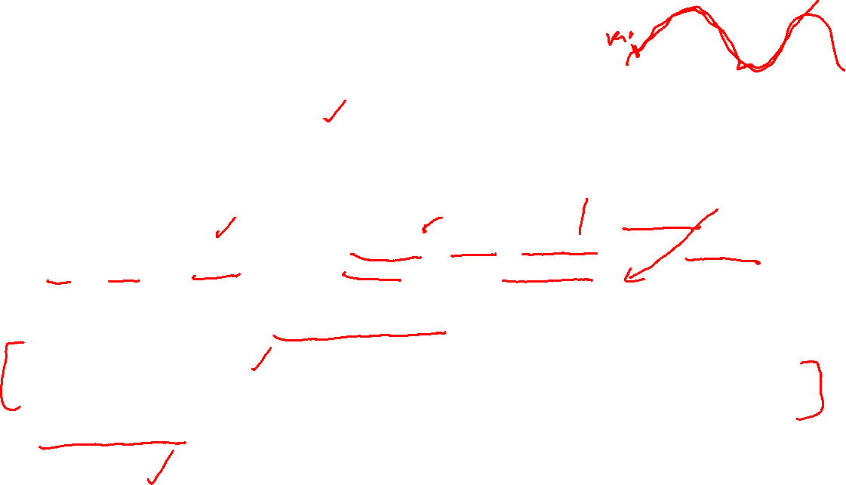
Multiple Perspectives on Globalization
Multiple perspectives on its origin
As basic human instinct,
as a long-term cyclical process,
as a series of historical epochs or waves, each with its own point of origin
multiple points of origin of globalization are located in seminal historical events,
New phenomenon of late twentieth and early twenty-first centuries
Alternative perspectives on key drivers : Materialistic vs ideational
Forces and relation of production- capitalism, MNCs, Technology are the key drivers
Ideas, thinking, information and knowledge driving globalization
Multiple perspectives nature of expansion of globalization.
Globalization from Top vs Globalization from below
From Top: by large-scale forces, such as the nation-state and the MNC of the ‘North’ imposed on the ‘South’
Globalization from below : Worldwide opposition of globalization from top by individual actors, groups of actors, social movements, etc
Anti- globalisation or alter-globalization movement
Alternative perspectives on its Impacts- good or bad

Slide 14
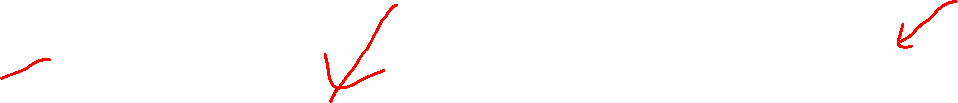
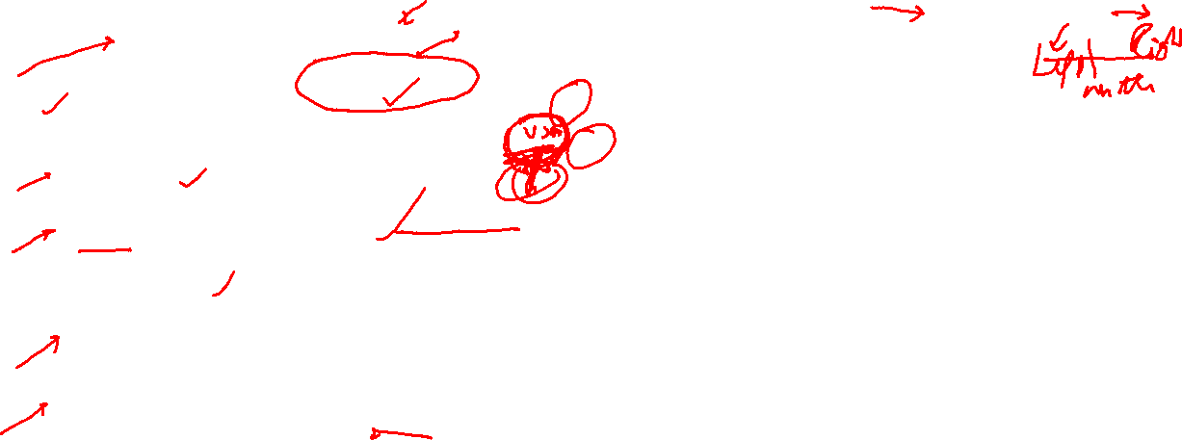
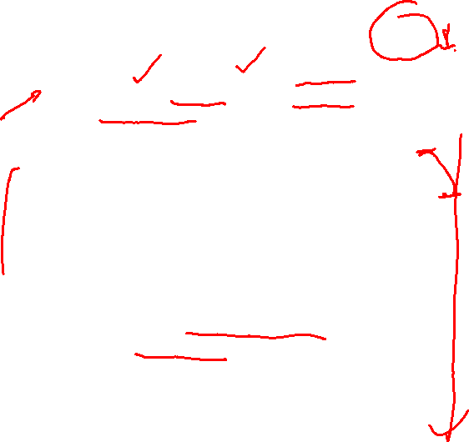
Alternative Perspectives on Impacts of Globalization
Pluses : Globalists or Globaphilia
Minuses : the Sceptics or Globaphobia
promote world peace, Human security and Economic well-being.
Faster Economic Growth and Increasing Democratization
Optimum resource utilization; global division of Labour
Great equalizer : ‘ Flat World’ : Friedman
Global Governance: IGO, and INGOs : UN, Greenpeace, Amnesty International, WWF
Break territorialization of Earth in boarders of nation-state ; furthering the spread of Global "civil society“
Promote universal human Rights, world community, respect for diversity, increases power to working in concert
Political Rights/conservatives
Immigration, Outsourcing, Job loss to locals, Cultural homogenization- cultural destructions, rising cultural backlash
Political Left/Liberals
Globalization as Neo-Imperialism
Increases Inequality and poverty – works against ‘Have nots’ and ‘Global South’
international financial organizations work for the interests of ‘North’
Increasing powers of MNC/TNCs vis a vis State
Reduce national Sovereignty, Democratic space, and govt’s accountability to citizen
Decreased social security and welfare
Environmentally unsustainable
Not opposed to idea of globalization per se, but neo-liberal globalization: its imposition from ‘North’, its corporate forms, protecting interests of ‘haves’, and its lopsided features

Slide 15
Dimensions of Globalization

Slide 16
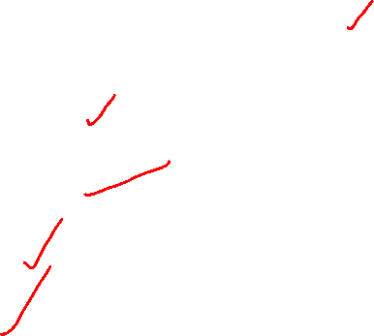
Dimensions of Globalization
Economic & Financial Globalization
Social Globalization
Political Globalization
Technological Globalization
Cultural Globalization

Slide 17

Dimensions or Types of Globalization
Economic Globalization
global economic integration ; economic globalization is globalization
Liberalization: Trade, Financial, Investment, Economic policy, Currency; Privatization- outsourcing, PPP
Political Globalization
Global Politics/IR in era of globalization
Issue of Sovereignty, territoriality, nation-state, statelessness, global governance, role of IGO, INGO, TNC, Global community, global movements, etc
Collective Dilemma :Global terrorism, Climate change, Migration, pandemic, Human security, Global poverty
Role of non-state actors in policy making & regulations ; Interconnectedness & interactions of cities/regions/organizations bypassing states
Social Globalization
State retreating from social welfare – retreat of welfare state
Less public spending, creation of public goods, and public services
Migration, family structure, community life, social security, adversely affected social stability
Conflicts between domestic social norms, social institutions and global social norms and institutions
Cultural Globalization
Homogenization- common global popular culture & Heterogenization- culture is becoming increasingly varied
Food, entertainment, Leisure, worldview, Ideologies, social practices – all affected , becoming globalized
Cultural relativism vs universalization
Technological Globalization
ICT revolution- Information Society
Pervasiveness of technology in daily life: Facebook, Google, Twitter, Microsoft, Apple, Samsung
Notes:
The integration of national economies into the international economy through trade, direct foreign investment, short-term capital flows, international flows of workers and humanity generally, and flows of technology’ (Bhagwati 2004)

Slide 18
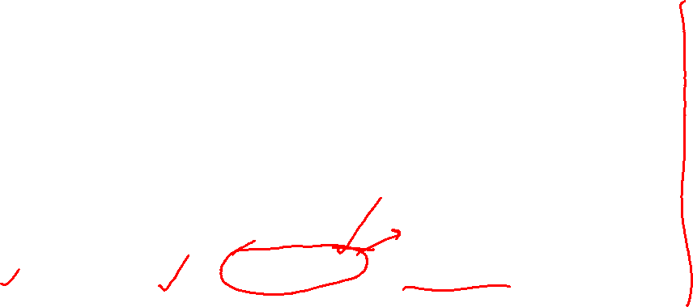
Economic Globalization: Meaning & Definitions
‘shift from a world of distinct national economies to a global economy in which production is internationalized and financial capital flows freely and instantly (OECD,1995)’
‘the web of economic interconnectedness and interdependence making the world economy as a borderless single global entity. ’(Ohmae 1990).
Absorption of national economies into an interlocking global economy
Liberalization: Free Trade, Financial, Investment- FDI, Economic policy, Currency; Privatization- outsourcing, PPP – LPG
Global Supply Chain, circulation of Hot money, Financial Integration
Denoted ideological victory of capitalism- market, private property and competition were accepted worldwide – global capitalism

Slide 19

Dimensions of Economic Globalization:
Free International trade
Since 1945, international trade has, on average, grown at double the rate of international production
$629 million in 1960 to $20,000 million in 2018 (32 times!)
Global Supply Chain: Globalized production, distribution , and consumption
Global division of labour – BPO, Off shoring
Globalized financial system
freely convertible currencies, free flow of capital & money, global currency trading
Rising global economic inequality

Slide 20
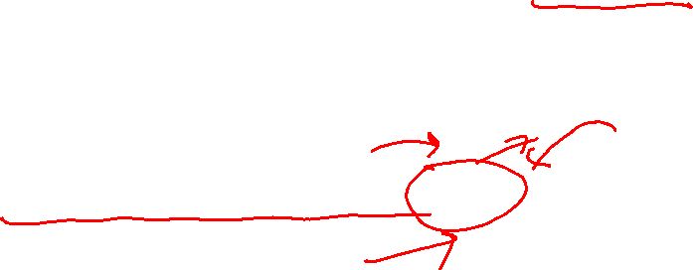
Social Globalization
State retreating from social welfare – retreat of welfare state
Less public spending, creation of public goods, and public services
Migration, family structure, community life, social security, adversely affected social stability
Conflicts between domestic social norms, social institutions and global social norms and institutions
Giving rise to Global Social Movement- WSF

Slide 21
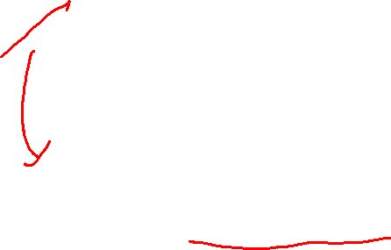
Political Globalization
triumph 'of Neo-liberalism- minimal state maximum market, liberalization, deregulation, privatization, individualism, and democratization
Changing nature of nation-state, dilution in state sovereignty
Arguments against:
Myth of Borderless World, Dominant role of state, Pooled sovereignty, Enduring attraction of the nation-state
economic globalization nevertheless requires a political framework that is provided by the state, notably in the form of the ‘military-territorial power of an enforcer’ (Robert Cox )
‘Internationalization of the state’ -State adjusting national economic practices and policies to the perceived interest of the global capitalist economy.
Return of the state
maintain domestic order and protect its citizens from external attack ; threat of terrorism, growing nationalism, conservatism
ICT : wider powers of surveillance, control and increasing regulation
Statelessness, weak, and failed state and state-building
Notes:
Robert Cooper : ‘postmodern’ state ; pooled sovereignty of states
The processes through which sovereign nation-states are criss-crossed and undermined by transnational actors with varying prospects of power, orientations, identities and networks’(Beck 2000)

Slide 22
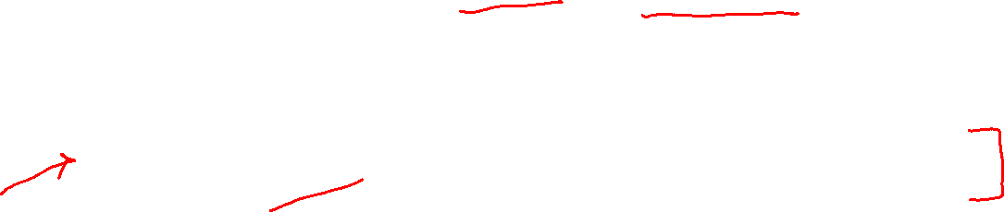
Cultural Globalization
Food, entertainment, Leisure, worldview, Ideologies, social practices – all affected , becoming globalized
Cultural Homogenization: Coca colaization, Macdonaldization : Flattening out of cultural differences
assault on local, regional and national distinctiveness; Cultural Hegemony
Cultural relativism vs universalization
Chief factors fueling cultural globalization
growth of TNCs , global media corporations –Netflix, Amazon Prime, Global social networking- Twitter, Fb, increasing popularity of international travel and tourism, ICT revolution
Cultural globalization as a ‘top-down’ process- global monoculture, cultural imperialism, ‘westernization 'or, ‘Americanization’
Two main ingredients of cultural globalization have been the global consumerism and the rise of individualism
Cultural Heterogenization: polarization and diversity; cultural backlash- rise of ethnic nationalism and religious fundamentalism

Slide 23
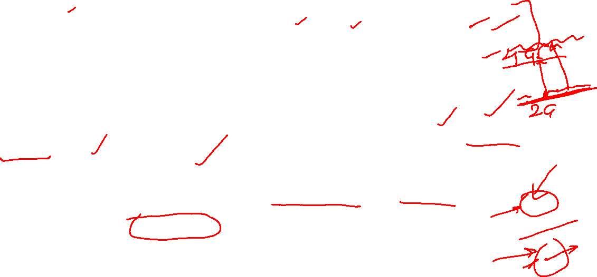

Technological Globalization
Technology, especially ICT, key drivers of Globalization
Printing press, Telegraph, Telephone, Semi-conductor and Computer, radio, TV, Mobile phone, satellite & transatlantic fibre cable, Jet plane, Internet, Plastic Money, GPS, AI, 3 D printing, e –Commerce, M-commerce, Mobile banking, cloud computing, IoT, Block chain, Machine learning, Crypto currency
technological diffusion, the spread of technology across borders driving technological innovation at greater speed
Technology driven Financial globalization: Electronic Transfer of Funds ( ETF), Society for Worldwide Interbank Financial Telecommunication (SWIFT)
Techno-globalism: rationalizes globalism on technological grounds ; technological determinism
Globalized society: Information Society : Knowledge or weightless society
Knowledge and high tech industries- Google, FB, Twitter, Microsoft, Apple, etc- are both drivers and face of globalization
Issues/Challenges: Digital divide; may increase inequality and gaps between ‘Have’ and ‘have nots’ ; ‘The North’ and ‘The South’
Notes:
Society for Worldwide Interbank Financial Telecommunication (SWIFT)

Slide 24
Globalization and Development
Globalization in the name of Development
Complex linkages to different dimensions of development
Positive or negative impacts depends upon how development is defined, where one lives, how far one is capable of, etc.
Overall very complex linkage; indeterminate impacts
Faster spread of crisis….financial crisis 97-98; prime lending, Pandemic?

Slide 25
Globalization & Development
Development as faster economic growth, material prosperity:
GDP risen impressively, global trade increased manyfold
Boon for many: MNCs, English educated ICT savvy young people in urban pockets of India, China, and other developing countries
But so has risen the inequality, economic misery and hardships to billions of people
Development as social well being, welfare, happiness
Development as social well being, welfare, happiness
Social equity diluted, welfare state gave way to full cost public services by market, consumerism caused psychological distress
Development as social harmony, cultural flourishment
Disharmony increased, clash of culture/civilization increased, cultural backlash against cultural hegemony and homogenization
Technological Dimensions
Technological dependence, Hegemony
Digital Divide further widened inequality
Generally adverse for farming community, small traders, small businesses, and local innovations

Slide 26
ICT4D and Globalisation
ICT has been the prime mover of the current phase of globalization
The world is now considered as global village because of time and space compression due to information and communication technologies
Global society is considered as information or knowledge society; majority of workers driving development are knowledge workers; all these are led by ICT
ICT itself is being propelled by globalization- global collaborative working, global brainstorming, global innovation, global supply chain
ICT for development denotes technology lead development in the globalised world

Slide 27
Globalization giving way to Slowbalization?
Globalization has given way to an era of sluggishness, or ‘slowbalization,’ a term coined by Dutch writer and trend watcher, Adjiedj Bakas in 2015
Global trade has fallen from 61 per cent of the GDP in 2008 to 58 per cent now.
FDI dropped from 3.5 per cent of the GDP in 2008 to 1.3 per cent in 2018.
PwC report: in 2019, the global volume of merchandise traded slowed down drastically and even went into reverse.
Growing movements for ‘Slow City’, Slow Food’, ‘slow travel’, ‘slow fashion’, ‘slow consumption’, ‘slow gaming’ and even ‘slow education’ !

Slide 28
Sum Up
Globalization is greater and faster interconnectedness of people, places, information, objects, activities, and exchanges across the Globe
Deep impact on all aspects of people’s life, academic disciplines, science, research, and technology
Alternative perspectives on its existence, extent, origin, key drivers, nature and impacts.
It is multi-faceted and Multi-dimensional- Economic, Social, Political, Cultural, Technological
Current phase of globalization is led by technological innovation and development oriented
But relation of globalization and development is indeterminate. ICT4D denotes technology led development in the globalized world

Slide 29
THANKS FOR WATCHING!
GOOD WISHES !

